Slide 1
Saqib Gulam Hussain Shaikh
Stock Market Analysis Report
Introduction:
Given historical stock price data for Apple, Microsoft, Netflix and Google over the past three months, we are going to analyze and compare the performance of these companies in the stock market using various data science
techniques. For this project, we are looking at their stock price data from the last three months. By analyzing this data, we can try to understand how each company’s stock performed, spot any patterns in price changes, and see how their performances are connected with each other.
This study will help us get a clearer picture of short-term market trends and give useful insights into how these companies move together or differently in the stock market.
Problem Statement:
In this project, the challenge is to take the stock price data of Apple, Microsoft, Netflix, and Google over the past three months and break it down into meaningful insights.
What needs to be figured out:
How each company’s stock has been performing. (Growth Rate with Legend) What patterns or trends we can notice in their movements. (Moving Average)
By answering these types of questions, the goal is to make the raw data easier to understand and more useful for decision-making.

Slide 2
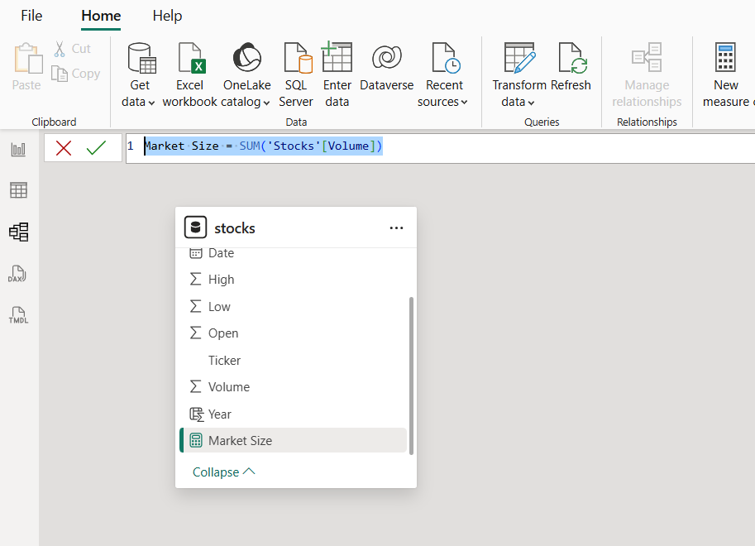
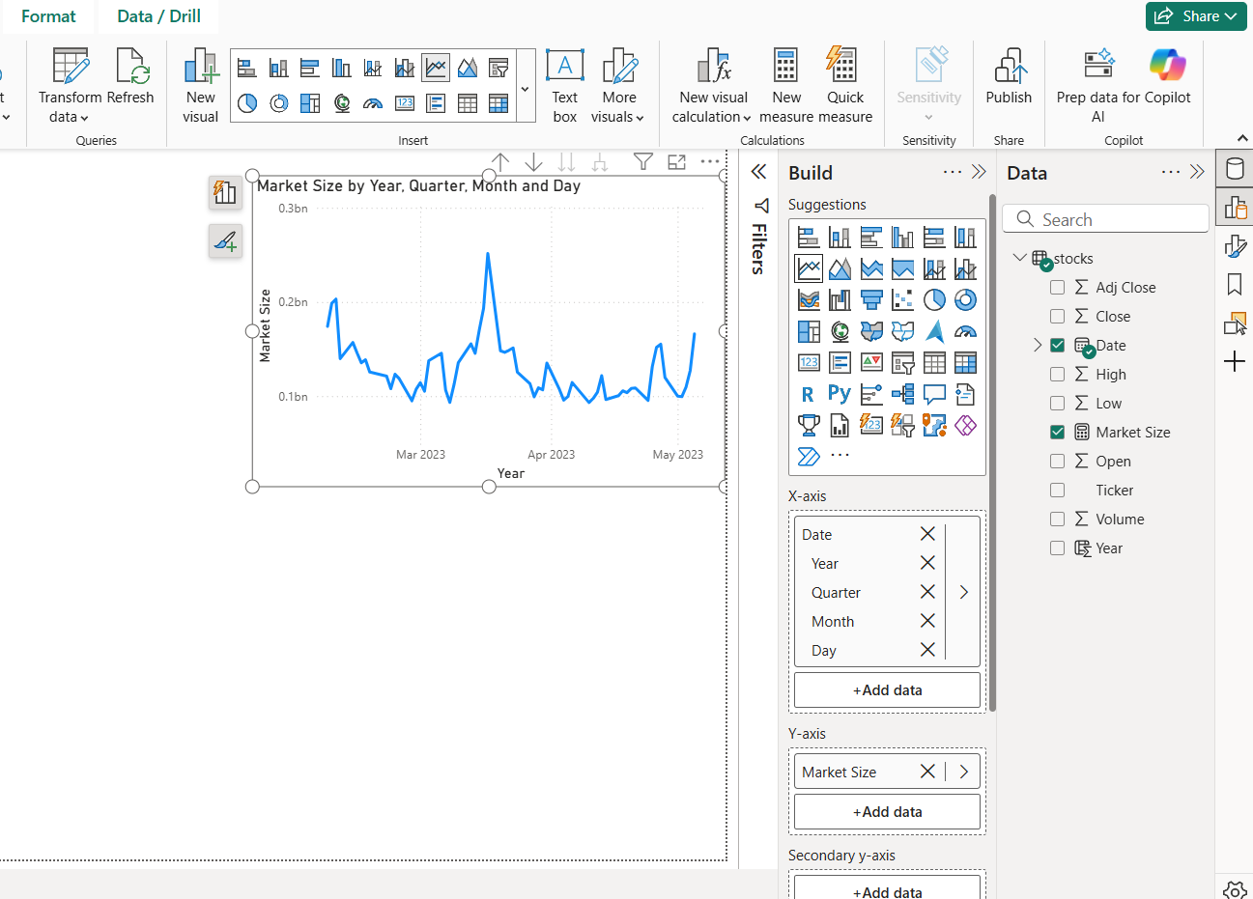
After importing the dataset into Power Bl. The next step as per the guide is to create basic charts:
Market Size Over Time: We can define Market Size as total market based on the volume (trading activities) of shares of every companies in the dataset. (eg: Sum of Volume) Creating a new measure for Market Size to calculate the volume of shares. Market Size = SUM('StockData'[Volume]):
Creating a basic line chart for Market Size over time: a) Added Date to columns (X axix) (As the dataset only contains data for 3 months and not multiple years, instead of visualizing Data by year, I have added the whole date hierarchy so that its more detailed and helpful). b) Added Market size measure to Rows (Y axix)

Slide 3
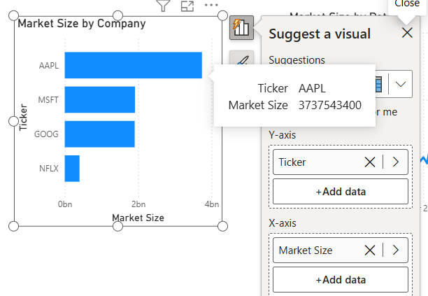
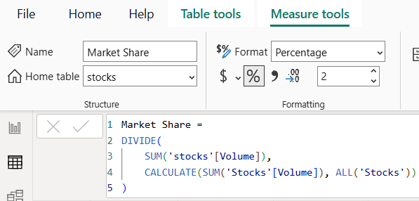
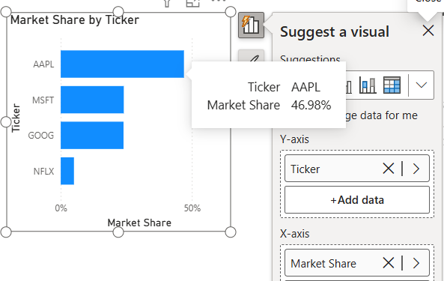
Creating a basic bar chart to display Market shares by company:
Although I can use the Market Size Measure for the visualization shown below:
But the Market shares will be visible in Numeric Values instead of Percentage
To visualize the Market Share in Terms of Percentage, Here I’ve created another formula that divides total stocks volume with the amount of selected company to calculate its percentage.
Added Ticker to (Y axix) & Added Market Share measure to (X axix)

Slide 4
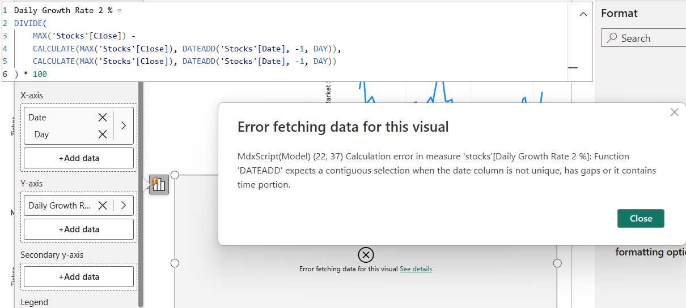
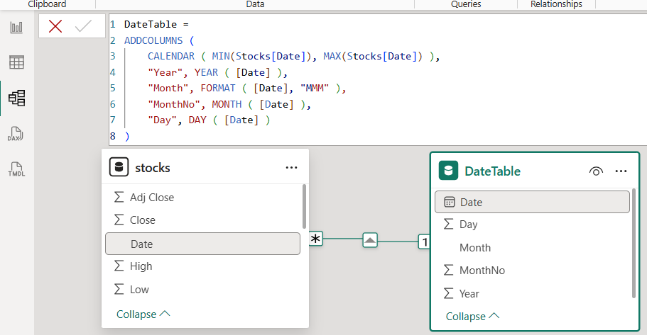
Creating a basic line chart showing Market Growth Rate: In simple, Growth Rate means how much a value has increased or decreased compared to the previous period (yesterday, last week, or last month). So the formula I’ll use is : Growth Rate = (Current Value−Previous Value)​ / Previous Value ×100
As we only have data for 3 months, I am going to create 2 measures, 1st for Day over Day Growth Rate, and 2nd for Month Over Month Growth Rate:
Daily Growth Rate (Day-over-Day % Change): based on the formula, An error (shown below) occurs as the Dataset have multiple Date present for different companies.
Therefore, I’ve had to created a separate Date Table and connected a relation with the Stocks Date, To measure each companies Growth Separately

Slide 5
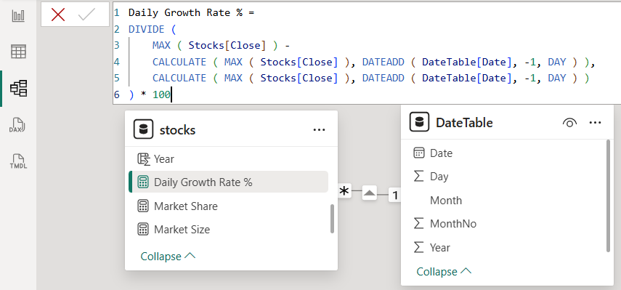
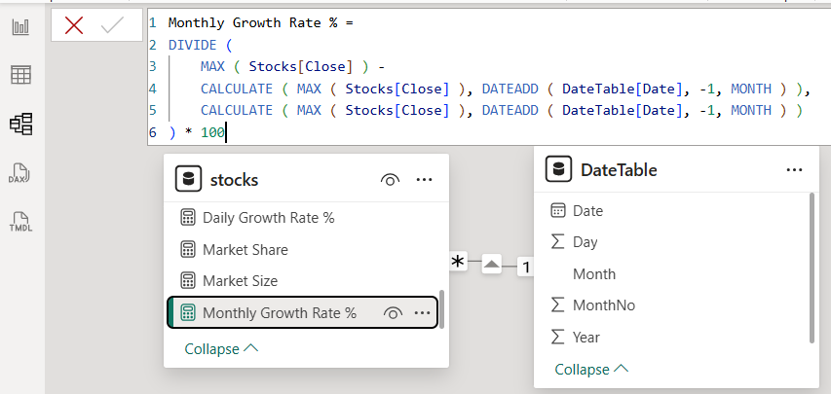
a) So rewriting the Daily Growth Rate Measure
b) Created a Monthly Growth Rate (Month-over-Month % Change) Measure:

Slide 6
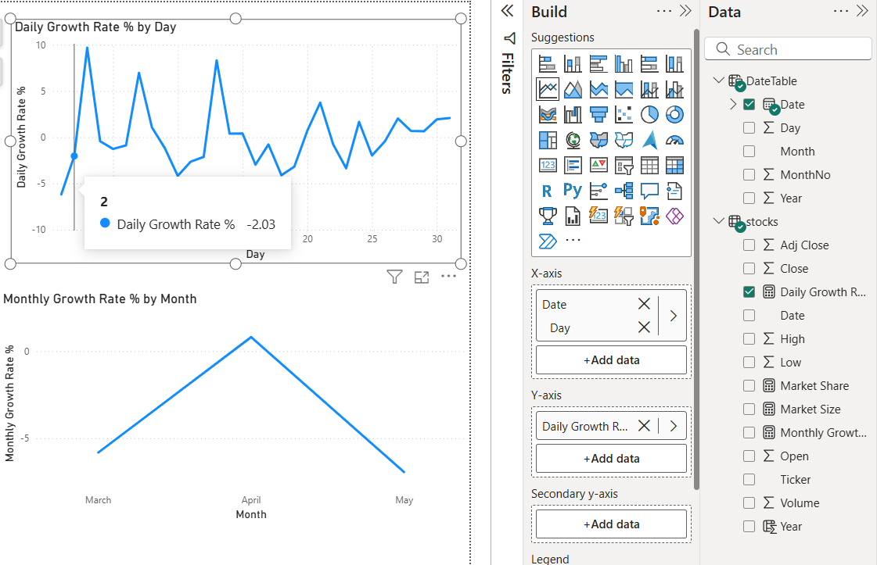
Here, I’ve Added a Line chart and Dragged the DateTable [Date] to (X axix) & Daily Growth Rate Measure to (Y Axis) Created another Line Chart and Dragged the DateTable [Date] to (X axix) & Monthly Growth Rate Measure to (Y Axis)

Slide 7
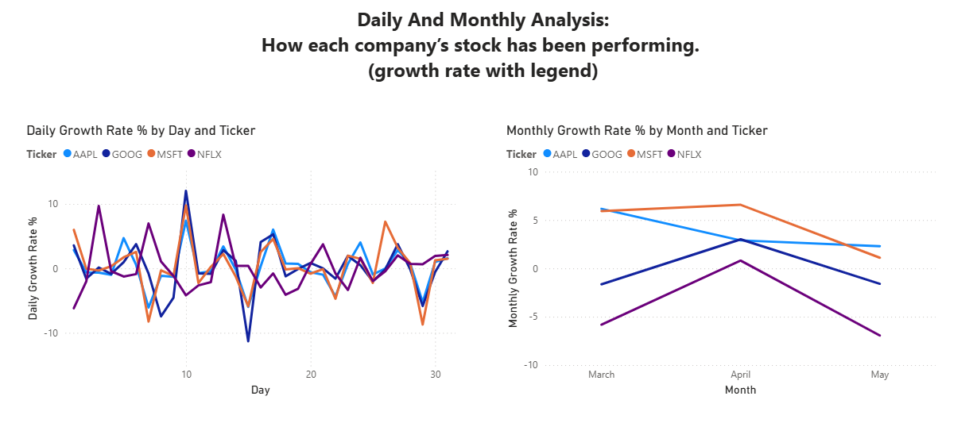
As there are no Data for Revenue, Profit, Income, Demographics, Or Regional Data provided in the Data se, I am unable to create the Heat Map, Or Consumer Demographics chart or the Competitive Analysis Chart. But, As per the problem statement, Here’s :
1) How each company’s stock has been performing. ( Here we can analyze this using growth rate with the Ticker as legend)

Slide 8
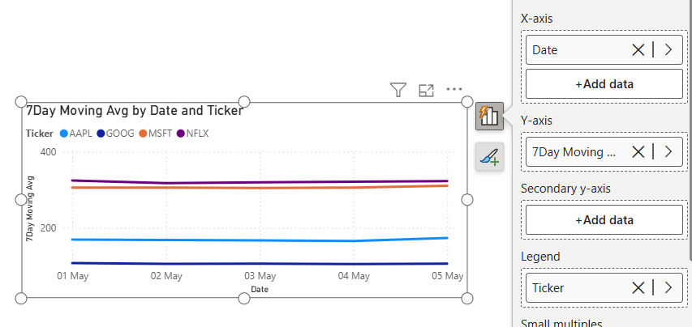
2) What patterns or trends we can notice in their movements. (Moving Average):
Here was use a 7-day moving average to identify overall trends while ignoring daily price fluctuations. From the chart, we can observe whether each stock is trending upward, downward, or remaining stable over time.” a
Hence, I’ve created a new Measure: 7Day Moving Avg =
AVERAGEX(
DATESINPERIOD(
'DateTable'[Date],
LASTDATE('DateTable'[Date]),
-7,
DAY
),
CALCULATE(MAX('stocks'[Close]))
)
Here I’ve added Date to X-axis, New & Day Moving Average Measure to Y-axis & Ticker in the legend.

Slide 9
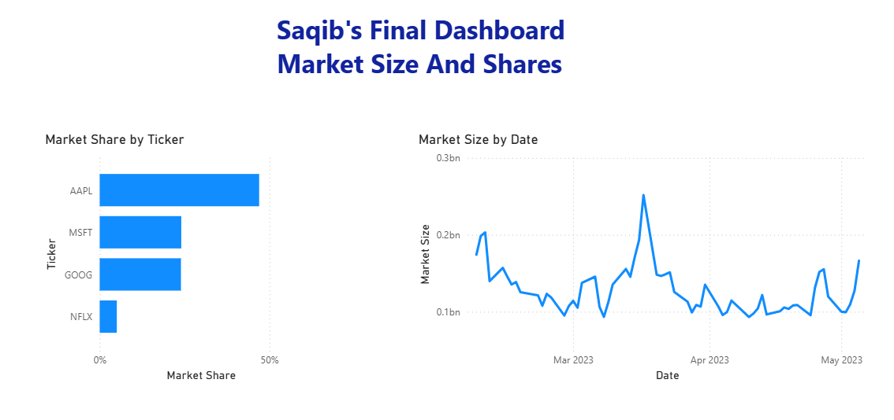
The Final Dashboard
Final Dashboard Consists of 2 Pages:
1: Market Size And Shares
2: Competitive Analysis
Dashboard 1: Market Size And Shares

Slide 10
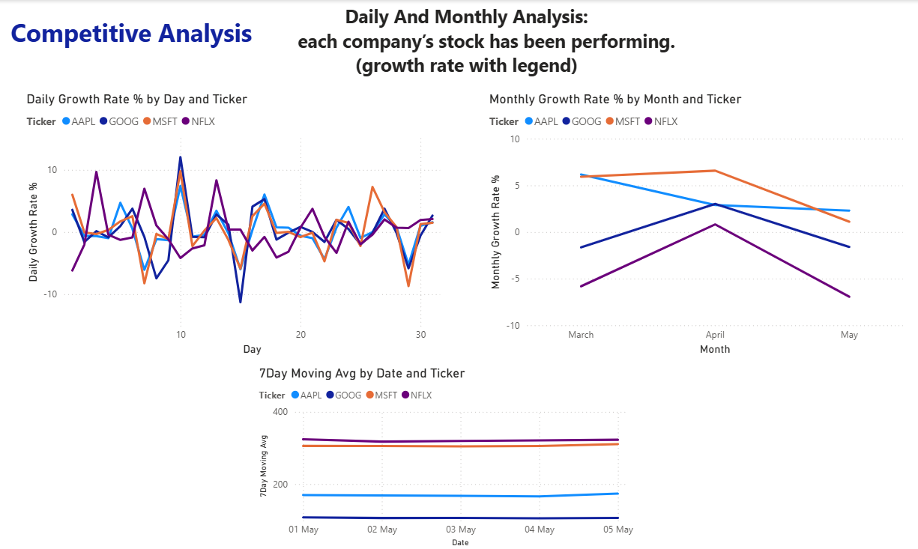
Dashboard 2: Competitive Analysis
Thank You

